Slide 1
CHIBOODLE INC
REVENUE FORCASTING
By: Abiodun Macfoy

Slide 2
Chiboodle’ revenue grew by 8.8% in 2015; Growth was driven by product segment Drinks

Slide 3
Most of the growth in 2015 came from new locations.

Slide 4
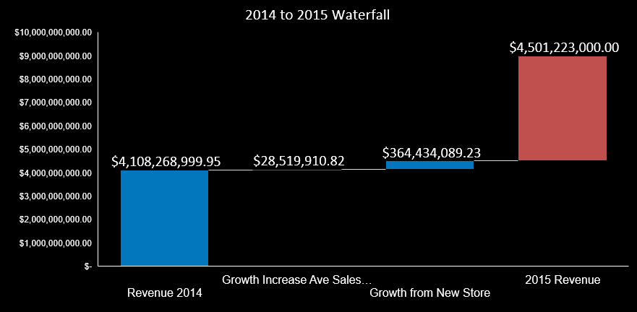
Most of the growth came from the Newly Opened Stores

Slide 5
We cannot rely on new stores’ growth since they are declinning as a result of saturation of locations hence a depressed revenue growth.

Slide 6
“Business as usual” forecast: Revenue will grow to $6billion 2019
 | 2015 | 2016 | 2017 | 2018 | 2019
Number of Stores | 2443 | 2621 | 2779 | 2920 | 3046
Revenue per store (All Products) | $ 1,842,498.16 | $ 1,873,415.41 | $ 1,905,806.84 | $ 1,939,733.12 | $1,975,257.62
Burritos (revenue per store) | $ 700,149.30 | $ 694,608.72 | $ 689,111.99 | $ 683,658.75 | $ 678,248.67
Tacos (revenue per store) | $ 396,137.10 | $ 626,016.38 | $ 654,456.78 | $ 684,189.24 | $ 715,272.48
Kids Meal (revenue per store) | $ 147,399.85 | $ 151,899.56 | $ 156,536.64 | $ 161,315.27 | $ 166,239.78
Drinks (revenue per store) | $ 598,811.90 | $ 400,890.75 | $ 405,701.44 | $ 410,569.86 | $ 415,496.69
Chiboodle Total Revenue | $4,501,223,000 | $4,910,221,794 | $5,297,037,641 | $5,664,823,359 | $6,016,433,777
Revenue Growth % (Year on Year) | 8.73% | 8.33% | 7.30% | 6.49% | 5.84%

Slide 7

Project Crunch Forecast: Key Assumption / Methodology
The major challenge was to determine the revenue streams from the addition of a new product, in this case, Salad. I had to work back to the units of each of the products sold previously.
Units_Sold =$\frac{Product Revenue}{Product Price}$
From the units of products sold, and using the survey result that 8% and 23% of consumers of Burritos and Tacos respectively, we could estimate the expected units of Salad to the sold. For example, in 2015 – 71,081 units of Burritos and 102,712 units of Tacos were sold per store.
In the introductory year of the product, the management of Chiboodle planned
At 100% absorption rate, we’ll have: 8% of (71,081) + 23% of (102,712) = 29,310 units per store
However the plan of the management for Chiboodle was to introduce the product to an average of 17% of the stores which is:
Salad sold per store = $17\%∗\left(29310∗8.44\right)=\$41,248$ in the introductory year.
NOTE: The values for 2015 was used to estimate the values for 2016.
The price provided were static in nature and that would have been unrealistic. Therefore I used the Consumer Price Index (CPI)to project the inflationary effect on the prices to make a realistic dynamic price regime.
For CPI see: Bureau of Labor Statistics.
Website: bls.org

Slide 8
Project Crunch Forecast: With a new product addition, forecast revenue increased to $6.6 billion in 2019 using the mid-range price of $8.44
 | 2015 | 2016 | 2017 | 2018 | 2019
Number of Stores | 2443 | 2621 | 2779 | 2920 | 3046
Revenue per store (All Products) | $ 1,842,498.16 | $ 1,913,782.50 | $ 1,972,195.81 | $ 2,078,785.19 | $2,195,987.00
Burritos (Revenue per Store) | $ 700,149.30 | $ 694,608.72 | $ 689,111.99 | $ 683,658.75 | $ 678,248.67
Tacos (Revenue per Store) | $ 396,137.10 | $ 626,016.38 | $ 654,456.78 | $ 684,189.24 | $ 715,272.48
Kids Meal (Revenue per Store) | $ 147,399.85 | $ 151,899.56 | $ 156,536.64 | $ 161,315.27 | $ 166,239.78
Drinks (Revenue per Store) | $ 598,811.90 | $ 400,890.75 | $ 405,701.44 | $ 410,569.86 | $ 415,496.69
Salad (Revenue per Store) |  | $ 41,248.89 | $ 68,277.73 | $ 137,105.91 | $ 213,825
Chiboodle Total Revenue | $4,501,223,000 | $5,018,335,145 | $5,486,671,155 | $6,065,229,364 | $6,667,725,636
Revenue Growth % (Year on Year) | 8.73% | 10.3% | 8.5% | 9.5% | 9.0%

Slide 9
Scenario Analysis: If we price salad at Mid-Range, Chiboodle revenue will grow to $6.6 billion in 2019
Introduction of salads will increase revenue by $127.4M in 2016 IF 8% of Burrito and 23% of Taco consumers opted for Salads priced at top-range of $10.42 (Applying CPI – Inflationary dynamics).
Introduction of salads will increase revenue by $105.7M in 2016 IF 8% of Burrito and 23% of Taco consumers opted for Salads priced at mid-range $8.44.

